Slide 1
INTRODUCTION TO
INDUSTRY, MARKET,
& NETWORKING
Nicole Palidwor | Denver Outcomes | 2018
Notes:
Make sure markers and name plaques are on desks!

Slide 2


HELLO, I'M…
Nicole Palidwor
Career Coach/Outcomes Gal
How to get in touch with me:
Email: nicole.palidwor@generalassemb.ly
Slack: career-coach-nicole
LinkedIn: www.linkedin.com/in/nicole-palidwor/
Notes:
Have two cats named Gin and Tonic
Into Adventure Travel
Bike Everywhere
Come from a Commercial Art Background
Have spent the last 8 years in various denver agencies picking up skills
Most recently at BlueModus where I did Bacardi's websites,
currently consulting for iTriage as a UX Designer
I know a lot about the dev industry, especially here in Denver

Slide 3
HELLO, I'M…
Nick Anderson
Outcomes Guy/UXDI Instructor
How to get in touch with me:
Email: nick.anderson@generalassemb.ly
Slack:
LinkedIn:
Notes:
Have two cats named Gin and Tonic
Into Adventure Travel
Bike Everywhere
Come from a Commercial Art Background
Have spent the last 8 years in various denver agencies picking up skills
Most recently at BlueModus where I did Bacardi's websites,
currently consulting for iTriage as a UX Designer
I know a lot about the dev industry, especially here in Denver

Slide 4
AGENDA
Welcome to outcomes!
Structure of outcomes and skills taught
Identify the job search process and your role
Identify deliverables and tools built in outcomes
How to receive outcomes support after graduation
Have an understanding of Denver’s local tech market
Know the homework roadmap and what comes next

Slide 5
INTRO TO OUTCOMES, INDUSTRY & MARKET
BUT FIRST
Let’s talk about the Melanesian Islands And their role in World War II

Slide 6
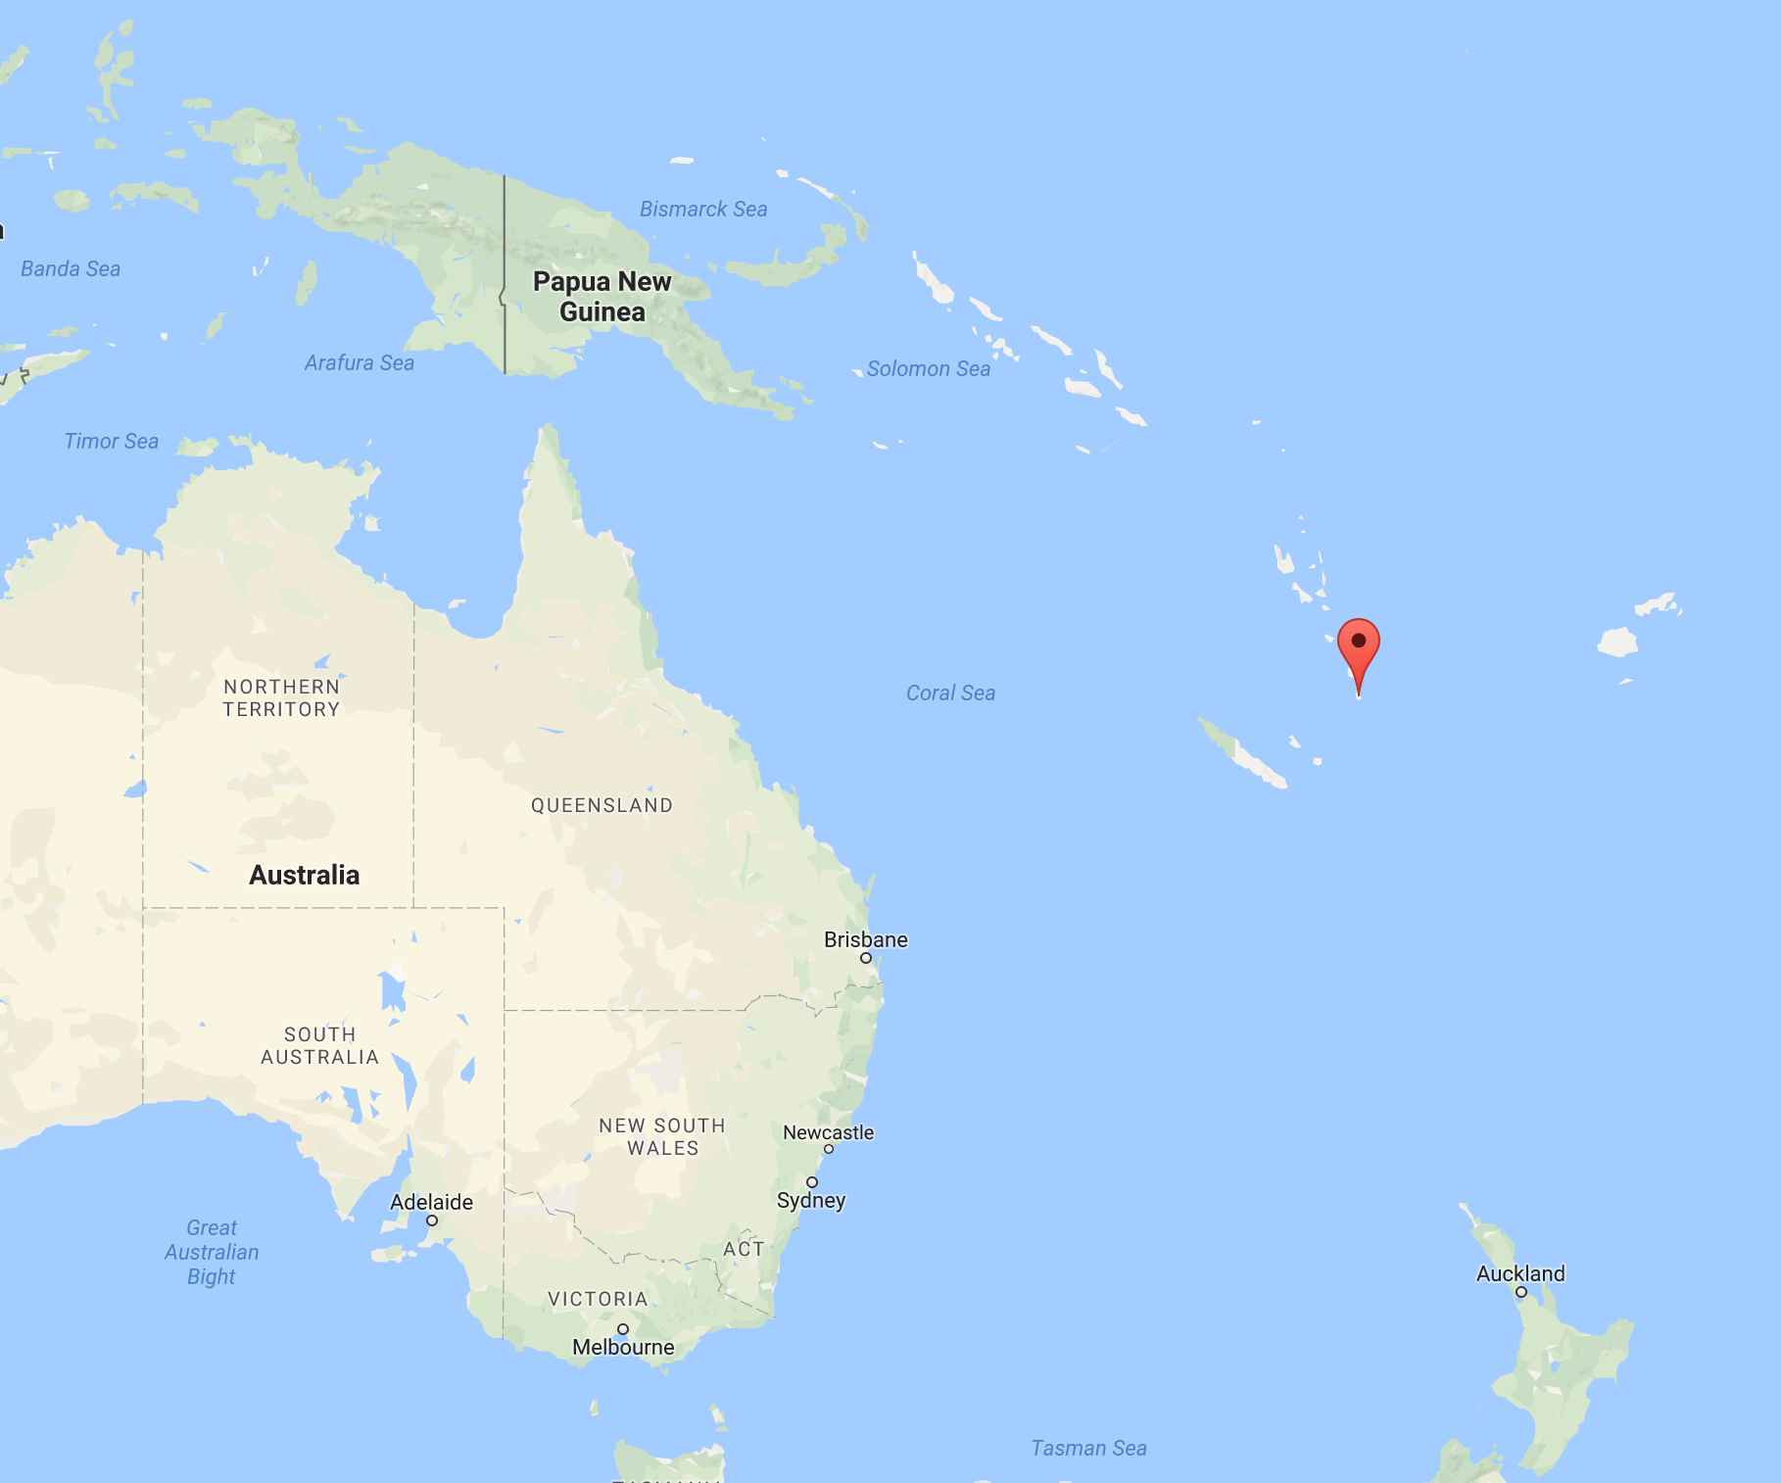
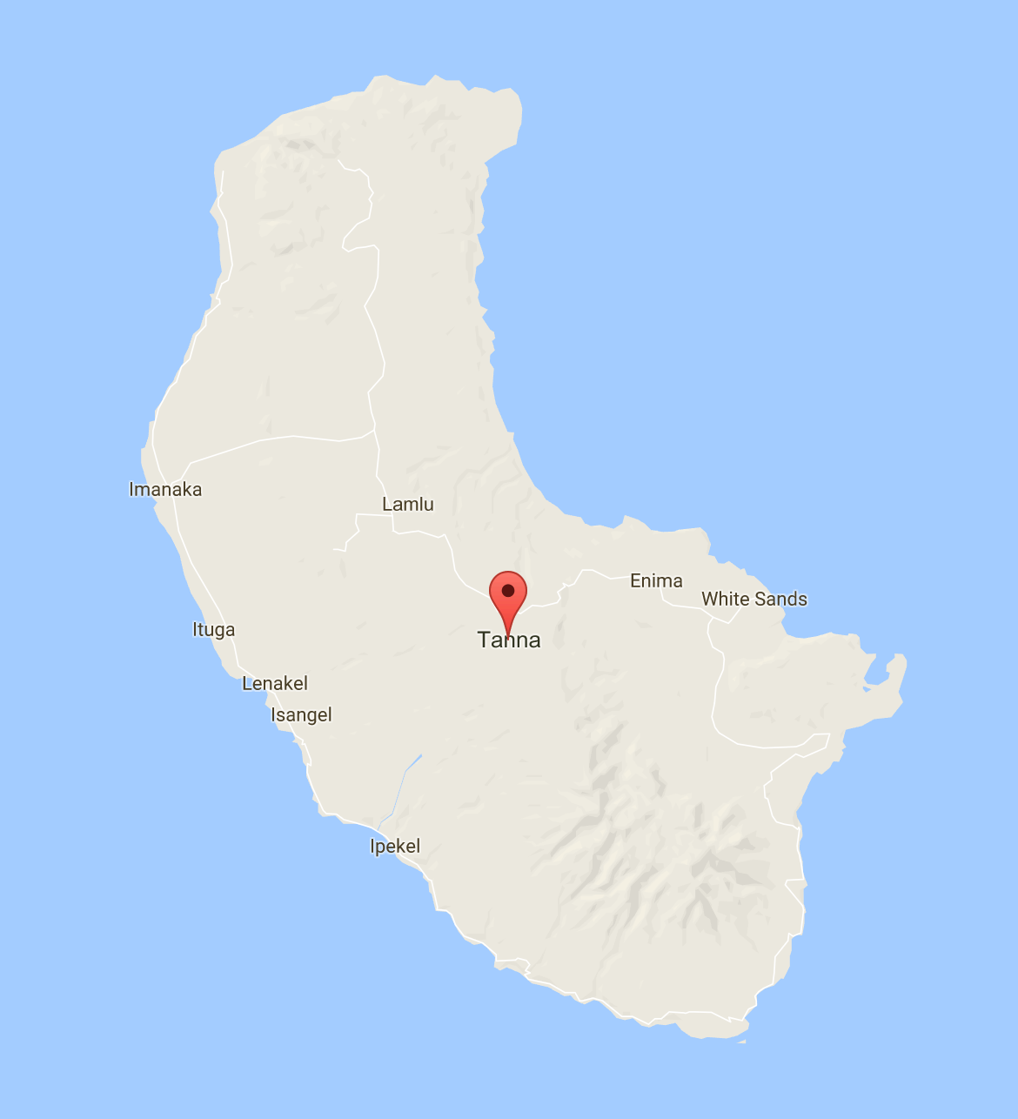

Slide 7





Slide 8


Slide 9


Slide 10


Slide 11


Slide 12
?
=

Slide 13
=

Slide 14


Slide 15


Slide 16


Slide 17
!=

Slide 18
???
???
!=
???
???
???
???

Slide 19
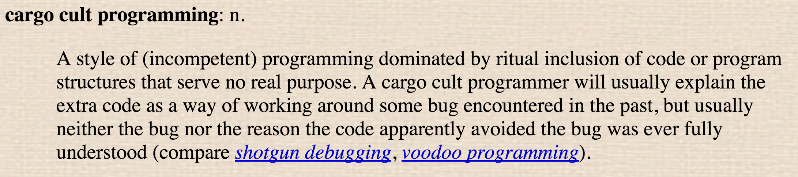

Slide 20
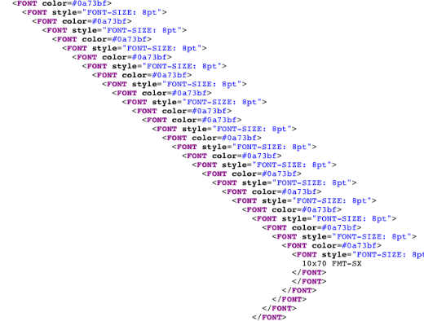

What you write
(i.e. copy/paste from Stack Overflow)
Notes:
What you write

Slide 21

What you see
Notes:
What you write

Slide 22

What you look like

Slide 23

Notes:
What I would rather see
It might not work great, but that’s all you

Slide 24
INTRO TO OUTCOMES, INDUSTRY & MARKET
OUTCOMES
MISSION & VISION

Slide 25

INTRO TO OUTCOMES
MISSION & VISION
Mission:
Outcomes is committed to the job preparation of our students and alumni through relevant and meaningful professional development opportunities.
Vision:
Our vision is put into action through programs and activities that foster professional stewardship to prepare, empower and motivate students to achieve career excellence and success.

Slide 26

WHAT WE DO
We promise to help you develop skills, expose you to opportunities, network, and ​provide continued access to resources that will help you succeed in your job search and career.
We promise to help prepare, empower and motivate you to achieve career excellence and success.

Slide 27

OUR SHARED GOAL
Our shared goal is for you to pursue a career that is aligned with your passions and the trajectory you envision.

Slide 28
INTRO TO OUTCOMES, INDUSTRY & MARKET
WHAT IS AN OUTCOME?

Slide 29
WHAT COUNTS AS AN OUTCOME?
Graduate achieving paid, full-time employment in their field of study
This includes contract, freelance and internships that are one month or longer
Full-time definition is >32 hrs/wk
Launching a company
GENERAL ASSEMBLY

Slide 30
WHAT DOES NOT COUNT AS AN OUTCOME?
Unpaid work
Part-time work
Job in an unrelated field
Returning to education path (college, additional bootcamp programming, etc.)
GENERAL ASSEMBLY

Slide 31
INTRO TO OUTCOMES, INDUSTRY & MARKET
PROGRAMMING

Slide 32






PROGRAMMING
5 THEMES TO SUCCESS
DESIGNING YOUR JOB SEARCH
Outcomes Roadmap
Job Search Standup
Goal Setting
Communication
DEVELOPING YOUR BRAND
Your Competitive Edge
Digital Presence
Search Etiquette
Interview
UNDERSTANDING THE LANDSCAPE
Industry Perspective
Digital Resources
Role & Company
BECOMING A THOUGHT LEADER
Application of Skills
Contribution to the Industry
Best Practices
PARTICIPATING IN THE COMMUNITY
Networking
Supporting Each Other
Social Media

Slide 33
BECOMING A JOB SEEKER
In order to qualify for Outcomes support, you’ll need to complete the following within two weeks of graduation. IDEALLY, by end of the course!
Participation in All Outcomes Programming& Surveys
Digital Presence (LinkedIn + GA Profile)
Job Search Tracker Participation
Networking (2 through the course)
Online
Portfolio
Resume
Notes:
Quality check, best foot forward - I will review your resume, LinkedIn, GA Profile, portfolio, and job tracker.
This will qualify you as a job seeker and kick off your job search.
You must be qualified within 4 weeks of completion of the program (pending specific circumstances) to receive my full support.

Slide 34













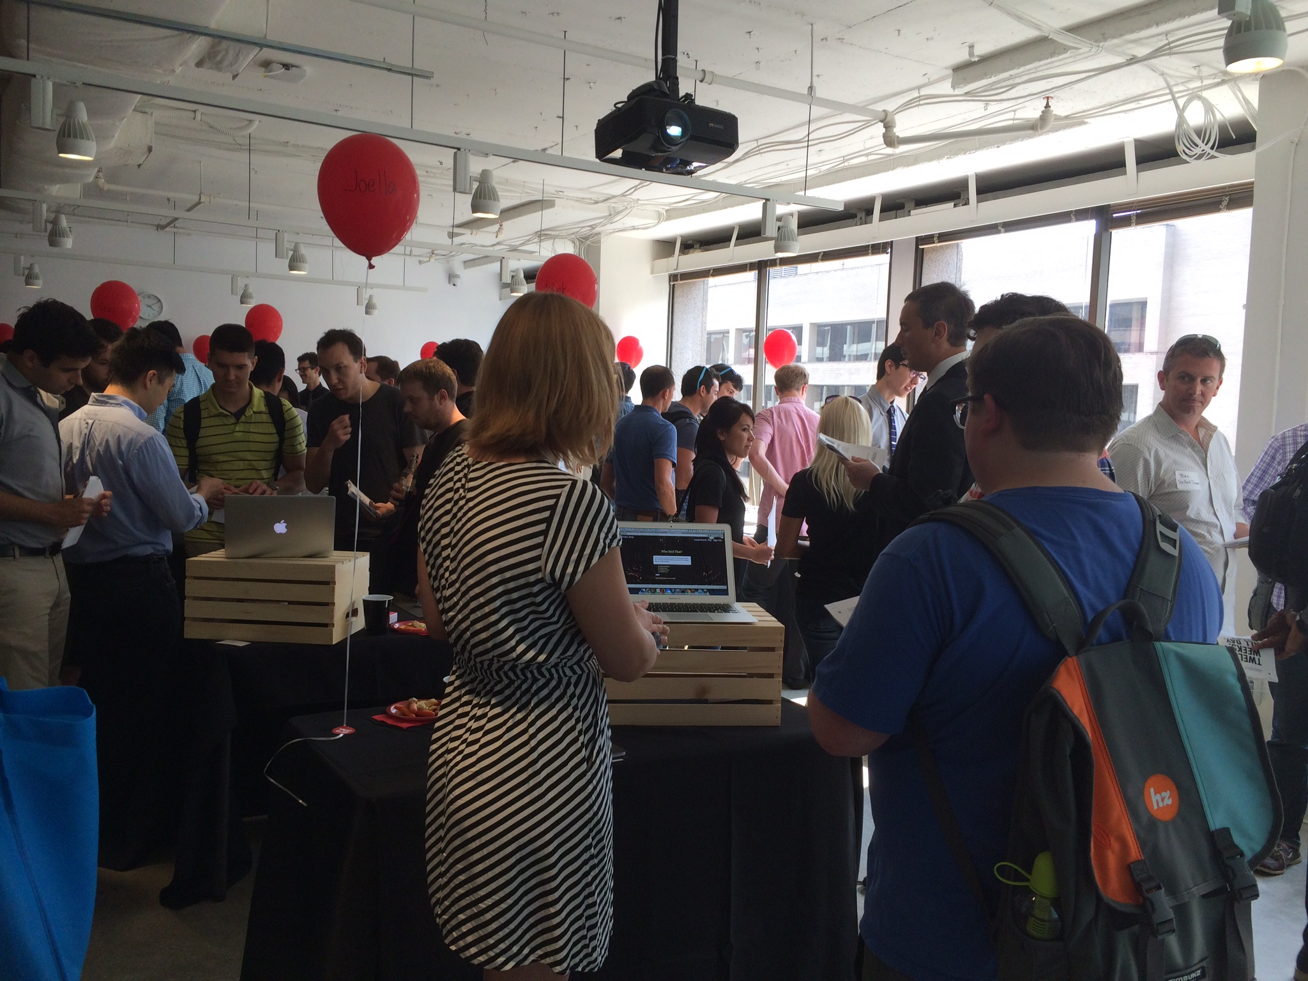

PROGRAMMING
BUILD YOUR NETWORK
LEARN JOB SEARCH TACTICS
Weekly programming
Define professional brand
Mock interviews, resume, online presence
GET PERSONALIZED ADVICE
ACCEPT AN OFFER
1-on-1 career coaching
Chat with mentors
Industry feedback
Hiring events
Apprenticeships
Personal job search support

Slide 35
PROGRAMMING
Outcomes Programming: A series of 90-120 minute job readiness trainings, which coach you through the tools needed to navigate the job hunt & happens weekly including:
‣ GA Profile & Portfolio
‣ Job Search Strategies & Cover Letters
‣ Interview techniques
‣ Life after
‣ Intro to Outcomes
‣ Local landscape
‣ LinkedIn/ Networking
‣ Resumes
‣ Branding

Slide 36



PROGRAMMING
EMPOWER YOU WITH SKILLS
PROVIDE YOU WITH TOOLS
OFFER SUPPORT
We do not take a hiring commission from companies that hire our grads
We are not recruiters or a job placement agency
We focus on providing programming + resources that will make you more confident in your job search

Slide 37
YOUR GOAL TO GET THE RESULTS YOU WANT
Results
Growth Mindset =
Open to coaching and goal setting
Job Search
Materials
Talking Points
Networking
Portfolio
GA Profile

Slide 38
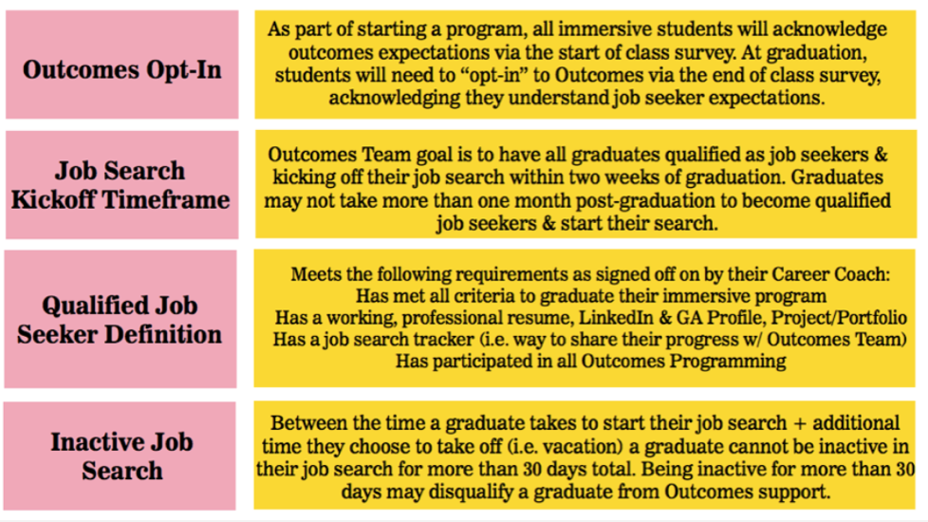

BECOMING A JOB SEEKER
one
Notes:
This is the nitty gritty, super important you understand this!
***Call on the students to read these!!!!!!
You will need to Opt-In in the end of class survey and graduate in order to qualify for Outcomes Support)
We’d love for you to start your job search as soon as possible, but know it may take some time.
Cannot exceed 1 month to qualify (or pause), we have seen that if students take too much time they lose their momentum.
Employers want to see that you are building your career after your education as soon as possible!
Why we have the boundaries?

Slide 39
INTRO TO OUTCOMES, INDUSTRY & MARKET
OUTCOMES:
THE PROCESS

Slide 40
IN-COURSE OUTCOMES SUPPORT
Courses
Support
Events
OUTCOMES LESSONS
JOB SEARCH TOOLS
1:1 MEETINGS
ON-DEMAND SLACK ACCESS
LUNCH + LEARN SPEAKERS
GA EVENTS
GENERAL ASSEMBLY
Notes:
These are the main three things we're gonna do for you, but we are available whenever you need us.

Slide 41
POST-COURSE OUTCOMES SUPPORT
Courses
Support
Events
REGULAR CHECK-INS
JOB TRACKING SUPPORT
1:1 MEETINGS
GROUP COACHING CALLS
ADDITIONAL POST-GRAD OUTCOMES EVENTS/SPEAKERS
GENERAL ASSEMBLY
Notes:
These will be covered either by me or the combo of me and one other person.
Main focus is getting you that first professional stepping stone after GA - Could be a full time job, internship, freelance contract, etc.
We are available whenever you need us.

Slide 42

YOUR JOB SEARCH STARTS NOW!
Develop your network
Start networking now - Meetups and events
Let people know what you’re doing
Think strategically
Understand where you belong and where you envision working.
Become an industry “thought leader”
Thought leadership just means you have something compelling to say.
Build your tools
Resume, portfolio, social media presences, business cards, cover letters, etc.
Lead your job search!
We can’t want this more than you!
GENERAL ASSEMBLY

Slide 43
INTRO TO OUTCOMES, INDUSTRY & MARKET
HOW TO SUCCEED IN THE OUTCOMES PROCESS

Slide 44
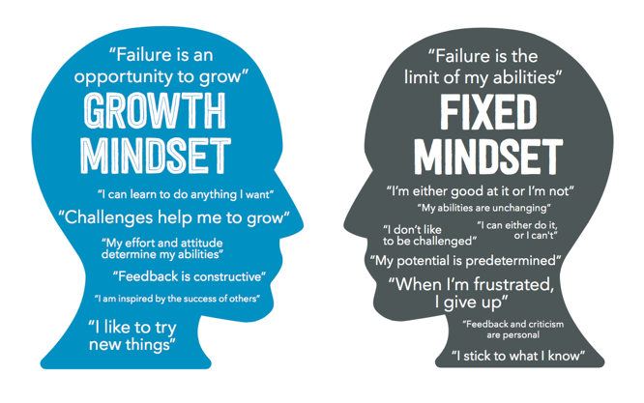
: Watch this

Slide 45
INTRO TO OUTCOMES, INDUSTRY & MARKET
JOB SEEKING STATUS

Slide 46
JOB SEEKING STATUS
These items will be reviewed at the end of course 1:1 and I will qualify you as a job seeker. You must be qualified within 2 weeks of completion of the program (pending specific circumstances) to receive post-course outcomes support.
These are basic requirements most companies are looking for from their applicants. By qualifying your materials, you know that you are best representing yourself.
Additionally, you must opt in to the Outcomes Program. This means you agree to follow the outcomes process & maintain regular communication with me. This will be done in the End of Class survey.

Slide 47
INTRO TO OUTCOMES, INDUSTRY & MARKET
EXPECTATION SETTING

Slide 48

EXPECTATION SETTING
STUDENT EXPECTATIONS
ESSENTIALLY….
We can’t want this more than you.
Your participation in the Outcomes process is vital to your success.
Trust in the process and approach everything with a growth mindset.
Stay focused - The Outcomes Roadmap is designed to keep you on track and plan ahead.
Set goals and embrace the 5 Themes to Outcomes Success.
Your success is our success.
Notes:
Outcomes curriculum is part of your immersive curriculum.
We are helping you develop the entire package.
Goal is to help you to get your job ASAP. 99% in 180 days, but majority get a job sooner than that.

Slide 49
EXPECTATION SETTING
Quality 6+ Job Applications/Week
Networking!
2+events/
month
2+ 1:1 coffee meetings/
month
Continued study & application of skills
Responsiveness to Coach + Weekly Completion of
Job Tracker Survey
Pet projects + working on your
portfolio
These activities are what have made our graduates successful in their job searches. This is what’s required to be considered a full-time GA job seeker. If you are not doing these things, we will have a conversation and develop an action plan to get you on track or if this is not possible, we’ll discuss moving you to part-time outcomes support.

Slide 50
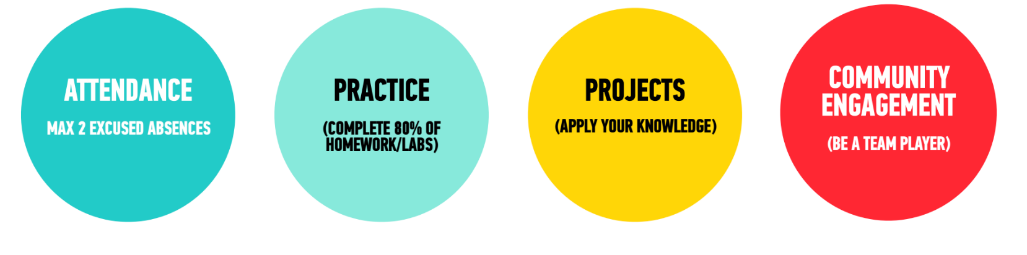
EXPECTATION SETTING
Treat this like your job
In order to qualify for job search support, we ask a few things from you:

Slide 51

EXPECTATION SETTING
YOUR PROMISE
I promise to embrace the fact that only I am in control of my path, and the only person who can guarantee my success is me. This plays largely into achieving your desired outcome.
I promise to remember that while changing my life is going to feel hard, scary, and lonely at times, I am never alone.
I promise to be a part of making the future of the General Assembly community stronger than it is today by sharing my wisdom, skills, talents, and support with fellow students and alumni.
If you Agree…nod YES

Slide 52
EXPECTATION SETTING
WHY IS THIS IMPORTANT:
Send out quality applications/week: It’s a numbers game - stay consistent. What you apply to now will build your pipeline later.
Update your career coach: We can’t help you if we don’t know what’s going on.
Attend 2-4 networking events: Networking is a huge part of your search! You will be building your network before you even need it.
1:1 meetings: Building relationships & having authentic conversations provides real exposure into the company and allows them to give you feedback.
Track your search: This will help you schedule your follow ups as well as keep track of where you’ve applied.

Slide 53
EXPECTATION SETTING
You keep mentioning this idea of “full outcomes support”, but what does that mean?
What’s included in post-course outcomes support?
1:1 Personalized Coaching
Candidate Recommendations to Companies
Access to GA Network/Connections
Access to continued job readiness practice (mock interviews, portfolio reviews)
Why does this matter?
Achieve outcome sooner
Personalized feedback
Actionable takeaways
Continued growth of your network

Slide 54
EXPECTATIONS: ACCOUNTABILITY
WHAT HAPPENS WHEN I DON’T HEAR FROM YOU:
The expectation we set with students & graduates is that they must be responding to Career Coach (or other Outcomes Team outreach) within 48 business hours.
If I don’t hear from you within 48 business hours, I will call or email you.
If I still don’t hear from you, I will call/email you again 2 days later.
From there, if no response, we will assume you are not interested in receiving outcomes support and we’ll stop reaching out.

Slide 55
INTRO TO OUTCOMES, INDUSTRY & MARKET
OUTCOMES:
MOVING FORWARD

Slide 56
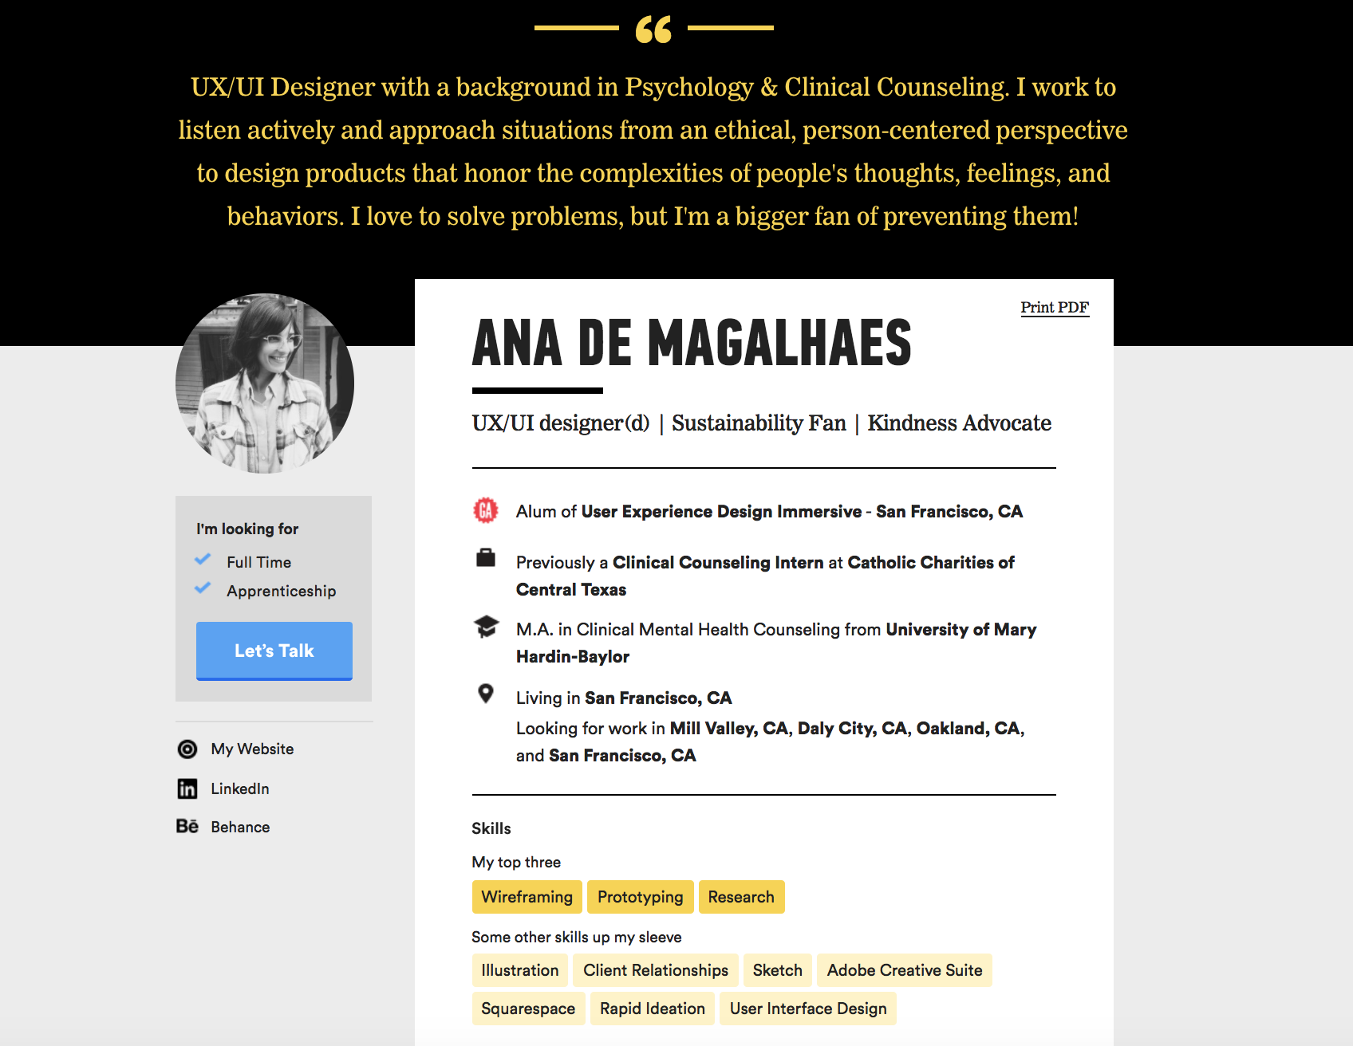
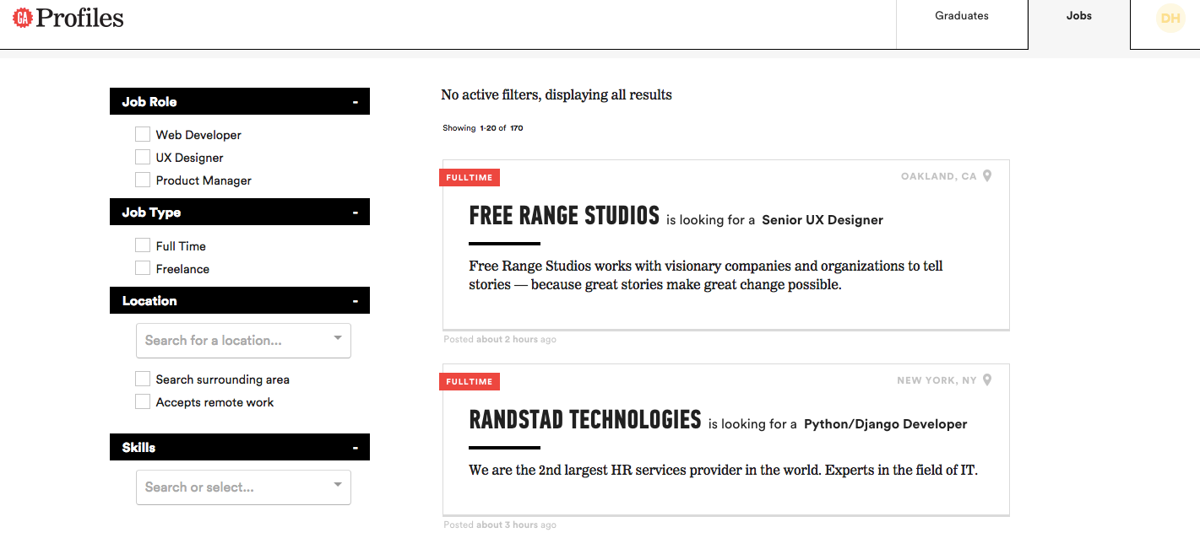
ALUMNI PROFILES AND JOB BOARD
“Hi Amy, I am a recruiter for a marketing agency in
San Francisco looking for a UX Designer. Your skills
match our requirements and I would like to set up a call
to get to know you”

Slide 57
OPPORTUNITIES
Lunch & Learn: Connect with leading practitioners to get a first-hand account from those working in the field!
Events: Partner with companies for exclusive hiring events for our grads
Meet with me 1: I’m here to support you with getting your outcome! I will also provide information, motivation and the occasional reality check

Slide 58
ONE-ON-ONES
You get one-on-ones with your Career Coach throughout the program.
1st one-on-one: I get to know you, learn your background, what brought you to GA, your goals, and how I can help. I will send an invite to you.
Follow up one-on-one: We can discuss your progress in class and job/ search plan for graduation. Bring a topic or questions to discuss
Final one-on-one: Qualifications review, edits, and discussion
Treat these one-on-ones the same as how you would an interview: show up on time, come prepared, and be ready to engage in a dialogue

Slide 59
SURVEYS
You will receive and need to fill out the following surveys:
Exit tickets at end of outcomes programming
End of Class survey
I Got a Job survey
NPS Survey - 100 days after graduating
On case-by-case basis: Non-Seeking Status survey

Slide 60
DENVER MARKET & LOCAL LANDSCAPE

Slide 61
DENVER MARKET
Denver considered one of the most promising in digital economy (Innovation that Matters report & tech.co)
Not just Denver - Boulder & Fort Collins considered to be an extremely innovative tech hub
Colorado Startup funding is growing rapidly:
$461M in 2013
$758M in 2014
$683M in 2015
$780M in 2016
$1.1B in 2017
Colorado has a thriving tech scene with a multitude of company types (which is rare)
Notes:
i.e. - Philly has a tech scene focused on tech in large companies, Silicon Valley has a focus on startups and private ventures
US Chamber of Commerce, 1776, & Free Enterprise. Looked at 25 cities, #3 on list
http://www.newyorker.com/business/currency/the-tech-booms-second-cities
Quality of life drives entrepreneurial activity,
NerdWallet, number of patents per 1,000 residents, Financial support for innovation, startups clustering together (Boulder highest density of startups)
Industries, forbes.com

Slide 62






DENVER SUCCESS STORIES: ACQUISITIONS
Notes:
Sources: Built in Colorado, Tech Crunch, Wall Street Journal, Denver Business Journal, Denver Post
In total, 59 Colorado digital tech companies were acquired or had initial public stock valuations in 2015, 23 more than 2014.
NetApp acquired SolidFire in 2015 - Founded in 2010. All-flash storage systems built for the next-generation data center where simple scaling, set-and-forget management, assured performance and multi-tenancy, and cloud economic models are driving new market growth.
- Zayo acquired Latisys, a colocation and infrastructure as a service (“Iaas”) provider.
The Carlyle Group and The Chertoff Group Acquire Majority Stake in Coalfire Systems, global security and cyber risk advisory
Amazon acquired 2lementry, which developed an enterprise-focused platform to track and manage IP-enabled machines and other connected devices
Purch acquired Active Junky, Active Junky partners with outdoor gear retailers to offer its members cashback rewards and other deals
Cognizant acquired TriZetto, who provides IT and other services to health-care providers and payers.
CA, which makes business software, was missing that key piece in its portfolio. Rally, the top provider of this agile software, filled the gap, CA CEO Mike Gregoire said in a statement.

Slide 63



DENVER SUCCESSES: LEGENDARY AGENCIES
Notes:
Legwork - Google, CocaCola, Nike, KFC
Crispin Porter + Bogusky - Dominos, Paypal, Burger King (creepy king), Carlsberg beer, The Tonight Show app LRXD - Naked Juice, Chiquita bananas, KC Masterpiece, Jack Link's Beef Jerky (messin with sasquach)

Slide 64








DENVER SUCCESSES: FORTUNE 500 COMPANIES
Notes:
Arrow Electronics #119 - Wholesaler, Electronics/office equipment
Dish #187 - satellite telecommunications
Davita #200 - healthcare medical facilities
Liberty Interactive #284 - Internet Services & retailing
Level 3 Communications #333 - satellite telecommunications
Ball #341 - packaging/containers
Western Union #468 - financial data services
ch2m #478 - engineering/construction

Slide 65



DENVER SUCCESS STORIES: GROWING STARTUPS
Notes:
Blinkr - car sales Denverite - hyperlocal Denver news Spruce - IoT (internet of things) shop

Slide 66
BLOGS AND ONLINE RESOURCES
Built In Colorado
Denver Egotist
Colorado Technology Association
Denverite - Startups
Meetup + any tech-related search word
AngelList
Tech.co Denver
Denver Business Journal - Tech News
Denver Post - Tech
Notes:
Do you guys have any favorites of your own?

Slide 67
STARTUP INCUBATORS
DENVER & BOULDER
Galvanize
Innovation Pavilion
Boomtown Accelerator
Techstars
NATIONAL
Y Combinator
500 startups
Angelpad
Companies that helps new and startup companies to develop by providing services such as management training or office space. Business incubators differ from research and technology parks in their dedication to startup and early-stage companies.
Notes:
Galvanize - Boulder & Denver, Galvanize Ventures is a seed-stage venture capital fund that invests in startups across the country
Innovation Pavilion - South Denver, Innovation Pavilion is evolving structured programs to connect Entrepreneurs with Angel Funding or VC funding firms with diverse funding sources ranging from seed to growth capital.
Boomtown - Boulder, Teams selected for each cohort receive $20,000 in seed money. Companies taking part in the program gain invaluable connections to enthusiastic mentors and investors. Curriculum is customized to the needs of the individual startup.
Techstars - Boulder (multiple locations), SendGrid is an alum. With the VC and Angel communities, we co-invest in companies built by Techstars alumni, mentors, and others across the ecosystem.
Y Combinator - Twice a year we invest a small amount of money ($120k) in a large number of startups (most recently 107).
500 startups - globally
AngelPad - NYC, SF

Slide 68
INTRO TO OUTCOMES, INDUSTRY & MARKET
WHAT DO WDI GRADS DO & WHAT DO THEY MAKE?

Slide 69
WEB DEVELOPMENT JOB DESCRIPTIONS
While ‘web developer’ is a title, the developer skills you have learned can be applied to a wide variety of roles.
There's hundreds of roles available for someone with web developer skills, in just as many work environments.
We're going to try to narrow down what type of work role/environment is right for you!
Notes:
Not only are these good to know for your conversations with potential employers, it also genreally illustrates that someone with technical skills wrote the job post, or contributed in some way

Slide 70
WEB DEVELOPMENT JOB DESCRIPTIONS
Frontend Developer (HTML, CSS, light JS)
Frontend Engineer (HTML, CSS, heavy JS)
Backend Developer (heavy JS, PHP, Ruby, .NET, etc)
Web Developer (Full Stack)
Technical Lead (HTML, CSS, JS, architecture & management)
Creative Technologist (Design + Full Stack)

Slide 71
WEB DEVELOPMENT JOB DESCRIPTIONS
People in tech can get a lot of funny job titles. When you run across the following, be wary as it is likely the one who wrote the post isn’t actually familiar with what the role involves.
Guru
Expert
Ninja
Rockstar
Genius
“Random Thing” Analyst
Chief “random thing” Officer
Always read descriptions - job titles can be misleading
Notes:
A sign that someone non-techinical wrote the job post. Not neccessarily a red flag, but you'll want to be sure to investigate further

Slide 72
PREVIOUS GA GRADS
We typically see salary ranges of $45,000 - $75,000
For contract work, we’ve seen ranges of $25 - $40/hour
Great resources to check out market rates:
Indeed
PayScale
Robert Half Technology Salary Guide
Simply Hired
Glassdoor*
Comparably
Notes:
As far as the future, development jobs can go up to $100-200k depending on your discipline and experience
I've see contracting rates as high as $95/hour
- Glassdoor is especially helpful as it is anonymous info from previous employees

Slide 73
INTRO TO OUTCOMES, INDUSTRY & MARKET
WHERE AM I GOING TO WORK?

Slide 74
WEB DEVELOPER COMPANY TYPES
There are lots of data science environments, each with their own unique pros and cons:
Agency
Product
Contractor
Type
Pros
Cons
Wide Knowledge
Deep Knowledge
Sweet Freedom
Shallow Knowledge
Narrow Knowledge
No Guidance
Notes:
A sign that someone non-techinical wrote the job post. Not neccessarily a red flag, but you'll want to be sure to investigate further

Slide 75
WEB DEVELOPER COMPANY TYPES
There's also lots of company types:
Startup
Mid-size
Corporation
Type
Pros
Cons
High Impact/Power
Stable w/ Freedom
High Stability/$$$
Low Stability/$$$
No Huge Perks
Low Impact/Power
Notes:
A sign that someone non-techinical wrote the job post. Not neccessarily a red flag, but you'll want to be sure to investigate further

Slide 76









PREVIOUS GA GRADS
Notes:
Globally

Slide 77
WHAT’S NEXT: HOMEWORK & ROAD MAP
INTRO TO OUTCOMES, INDUSTRY & MARKET

Slide 78
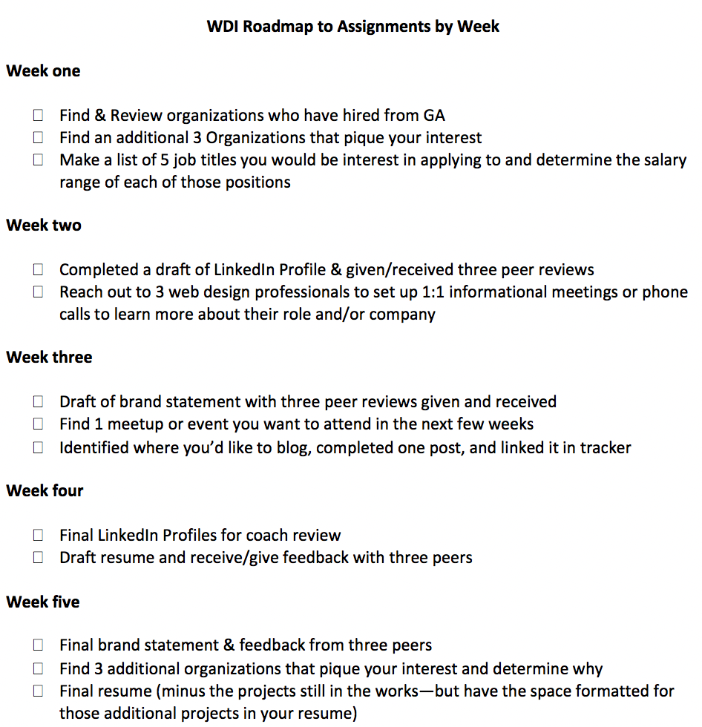
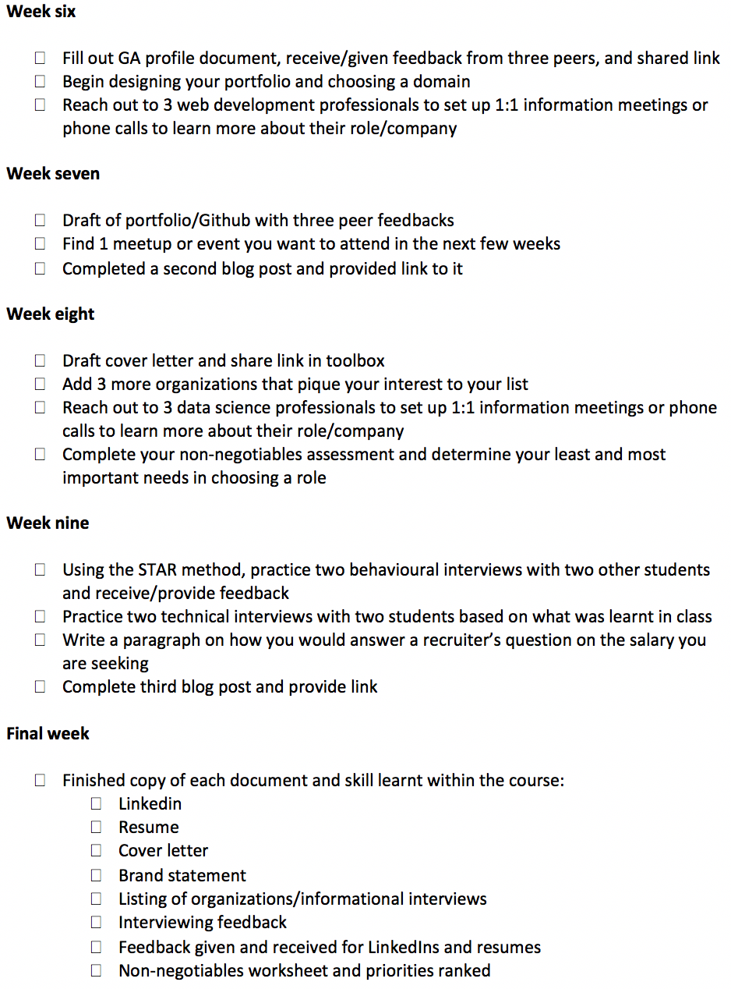

Slide 79
NEXT ON THE DOCKET
All course assignments, peer feedback, and research will be entered into THIS course toolkit document so please bookmark the direct link to the document.
You will make a copy of THIS personal job seeking document and you will SHARE your link to it and will then insert said link into THIS graduate job seeker master document.

Slide 80
NEXT ON THE DOCKET
This presentation will be uploaded to Slack
You will receive an invite from me to schedule your first one-on-one
You can access additional one-on-one time via:
www.calendly.com/career-coach-nicole
You will a receive a link to the assignment and activity tracking sheet
You will receive the weekly homework “on-track” guide sheet
You will feel free to ask any questions via Slack or e-mail!

Slide 81
THIS WEEK’S HOMEWORK
INTRO TO OUTCOMES, INDUSTRY & MARKET

Slide 82
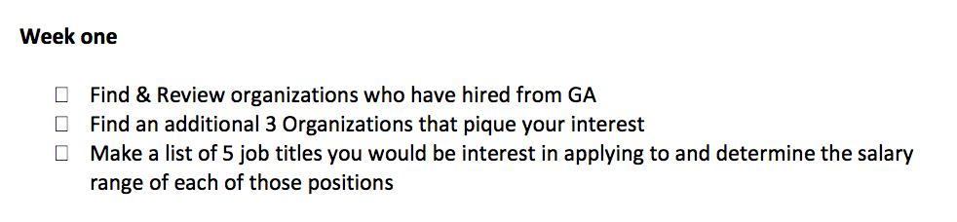
THIS WEEK’S HOMEWORK

